Slide 1

Planning for a new guide on Louisiana’s Inland and Coastal Fishes
Henry L. Bart Jr., Ph.D.
hbartjr@tulane.edu
Director and Curator of Fishes
Tulane University Biodiversity Research Institute
Belle Chasse, LA 70037

Slide 2
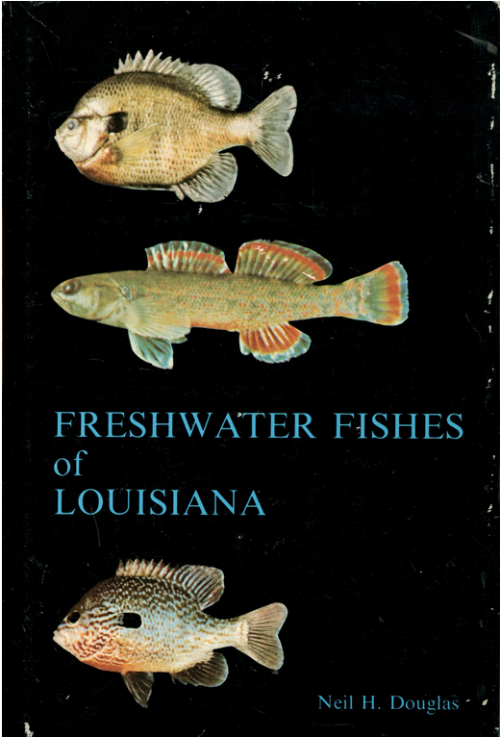
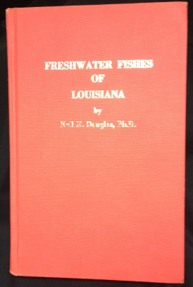
Neil H. Douglas’ (1974) Fishes of Louisiana
First comprehensive book on freshwater fishes in the state.
Covered all of the diversity known at the time;
Included dichotomous keys and accounts on each of the species;
Discussed drainage basins and geology of the state;
Not unlike other fish guides of its time: small, compact, handy for carrying out into the field.

Slide 3
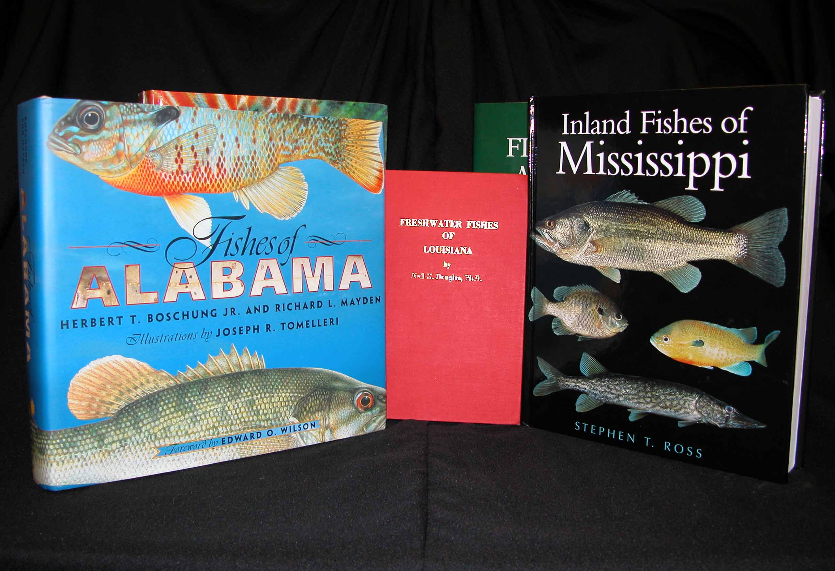
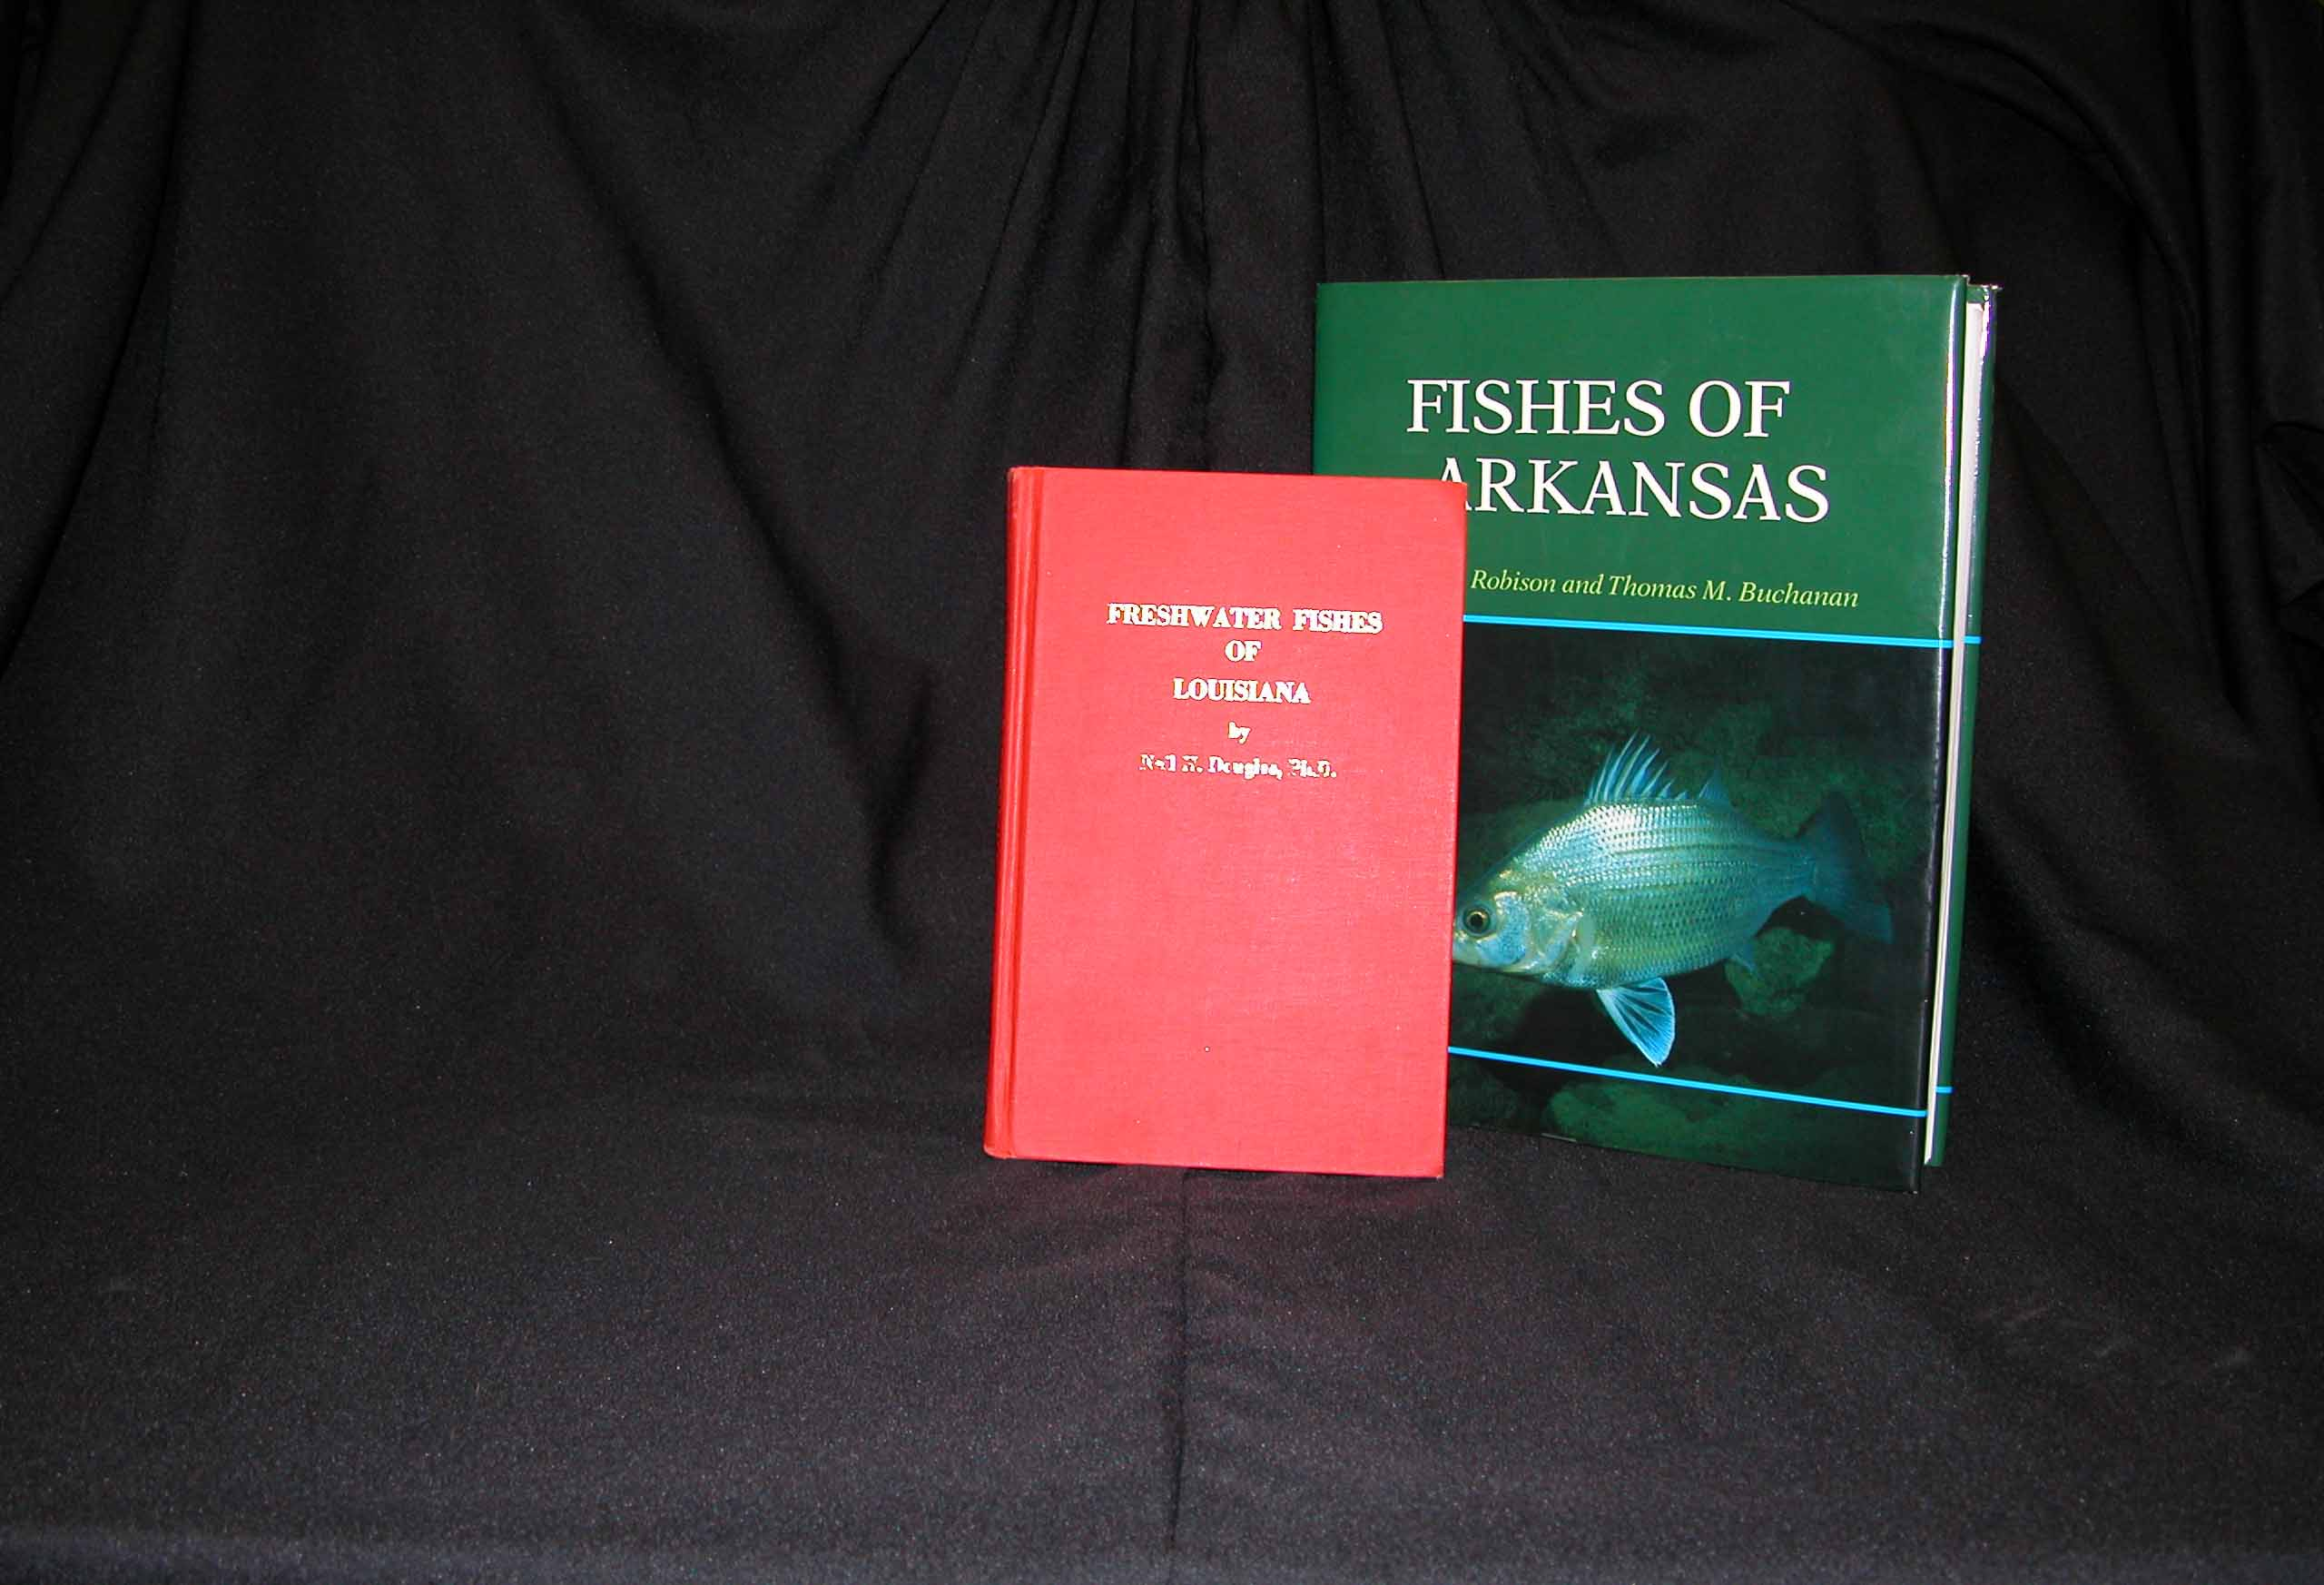
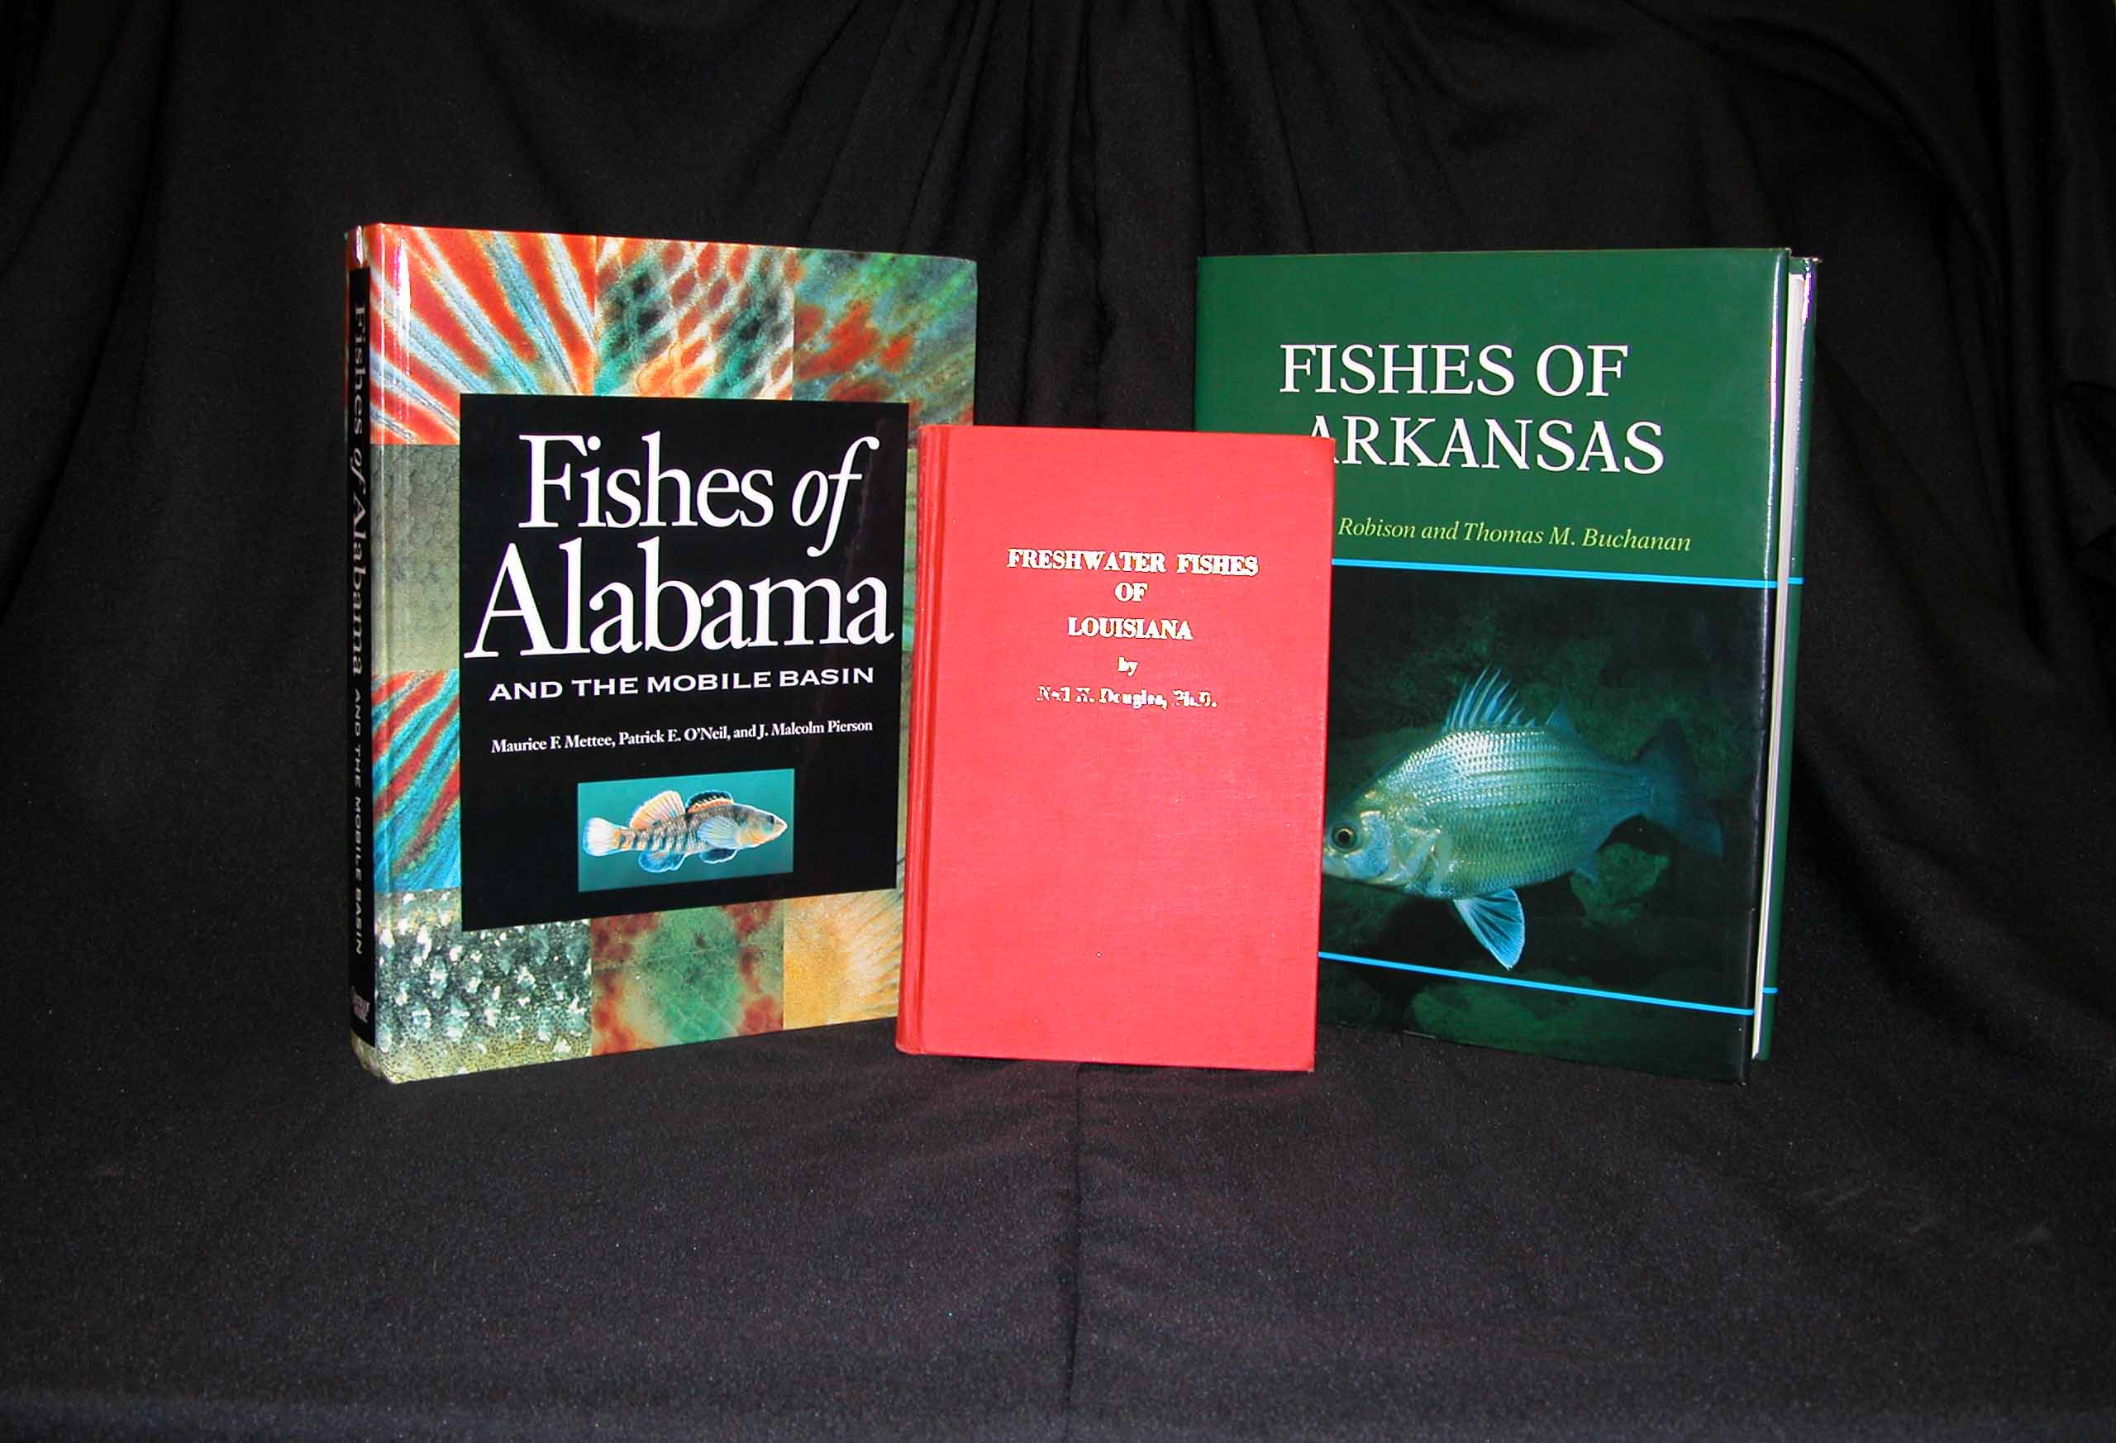
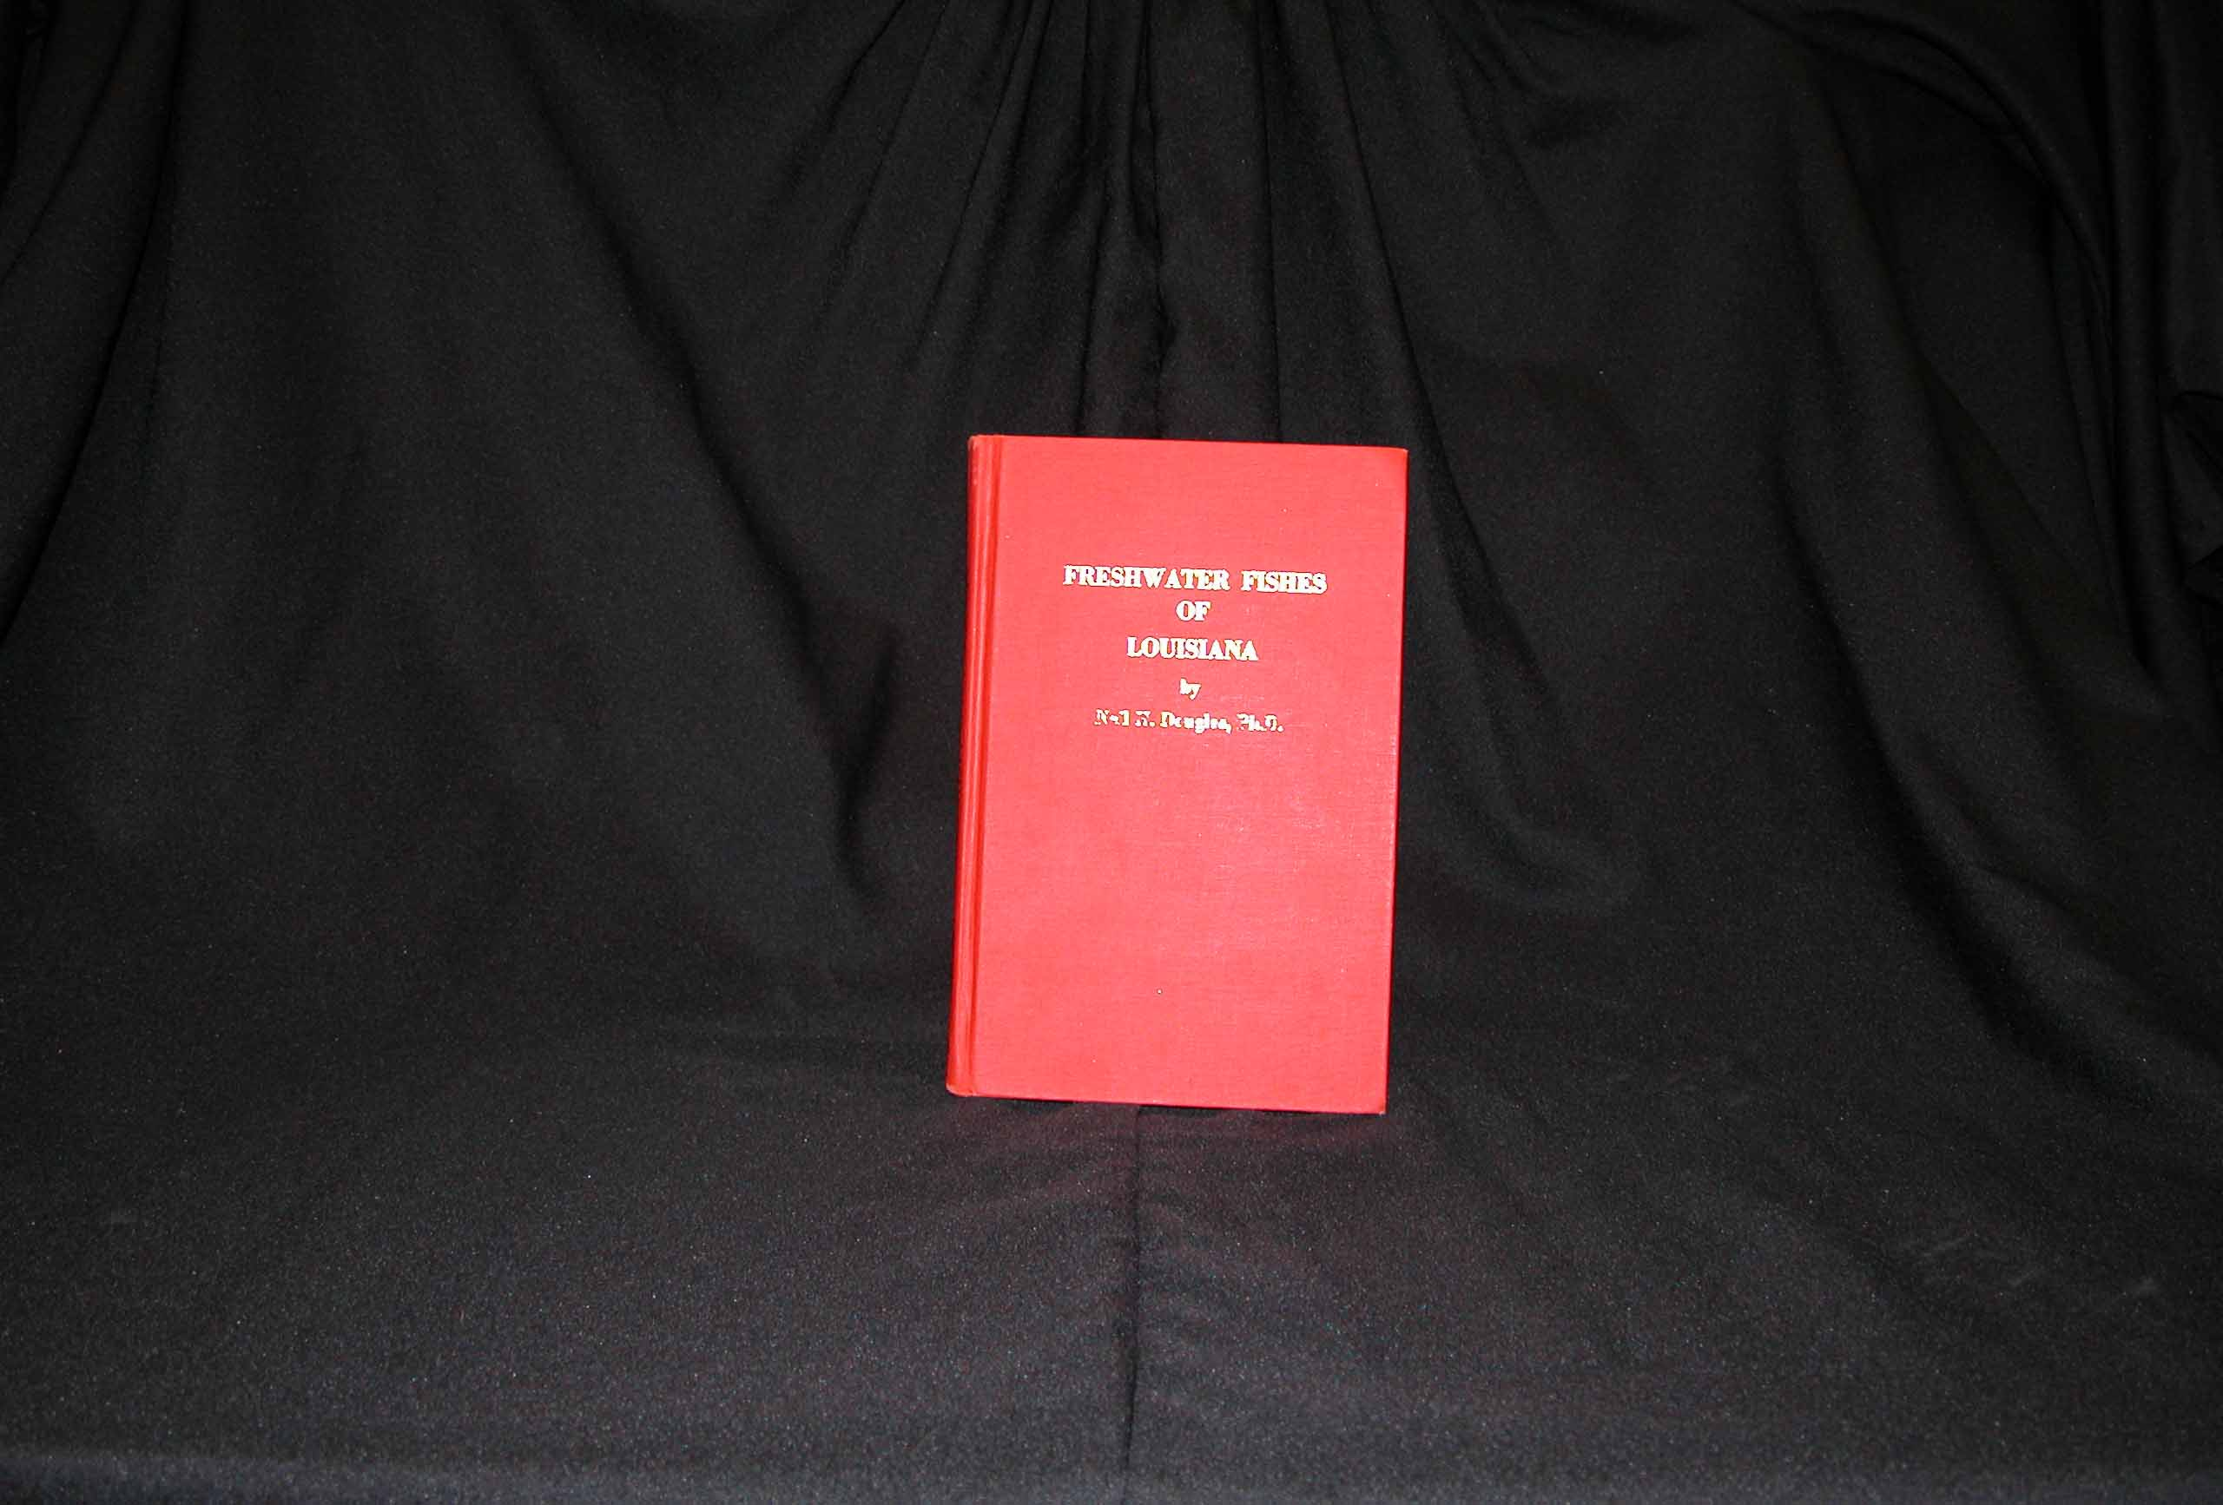
New paradigm in state fish guides
Fishes of Alabama, 1996
Fishes of Arkansas, 1988
Fishes of Alabama, 2004
Inland Fishes of Mississippi, 2001

Slide 4
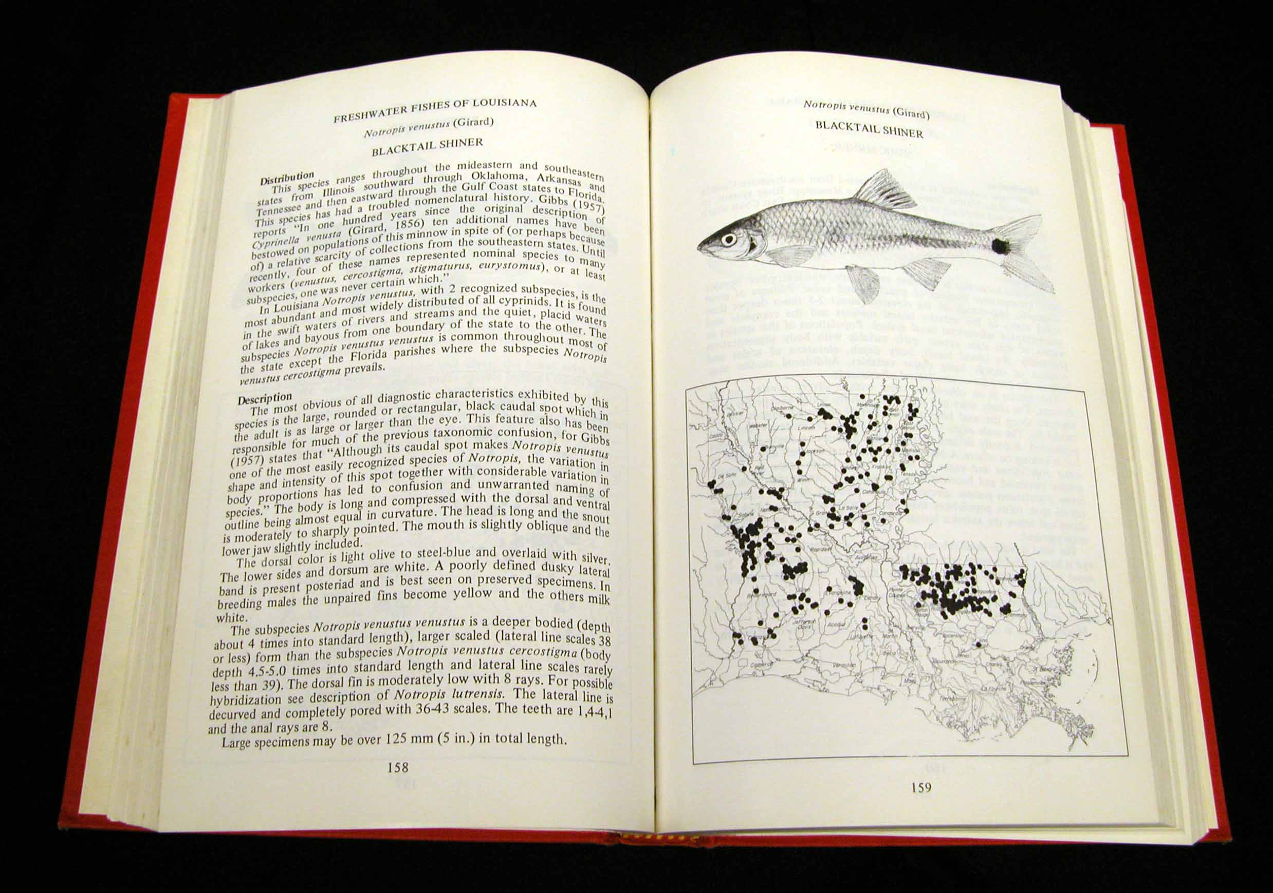
Species account from Douglas’ (1974)
Fishes of Louisiana
Pen and ink
illustration
of species
Geographic
distribution
Distinguishing
characters
Hand-made
Distribution
map
Very little information about biology

Slide 5
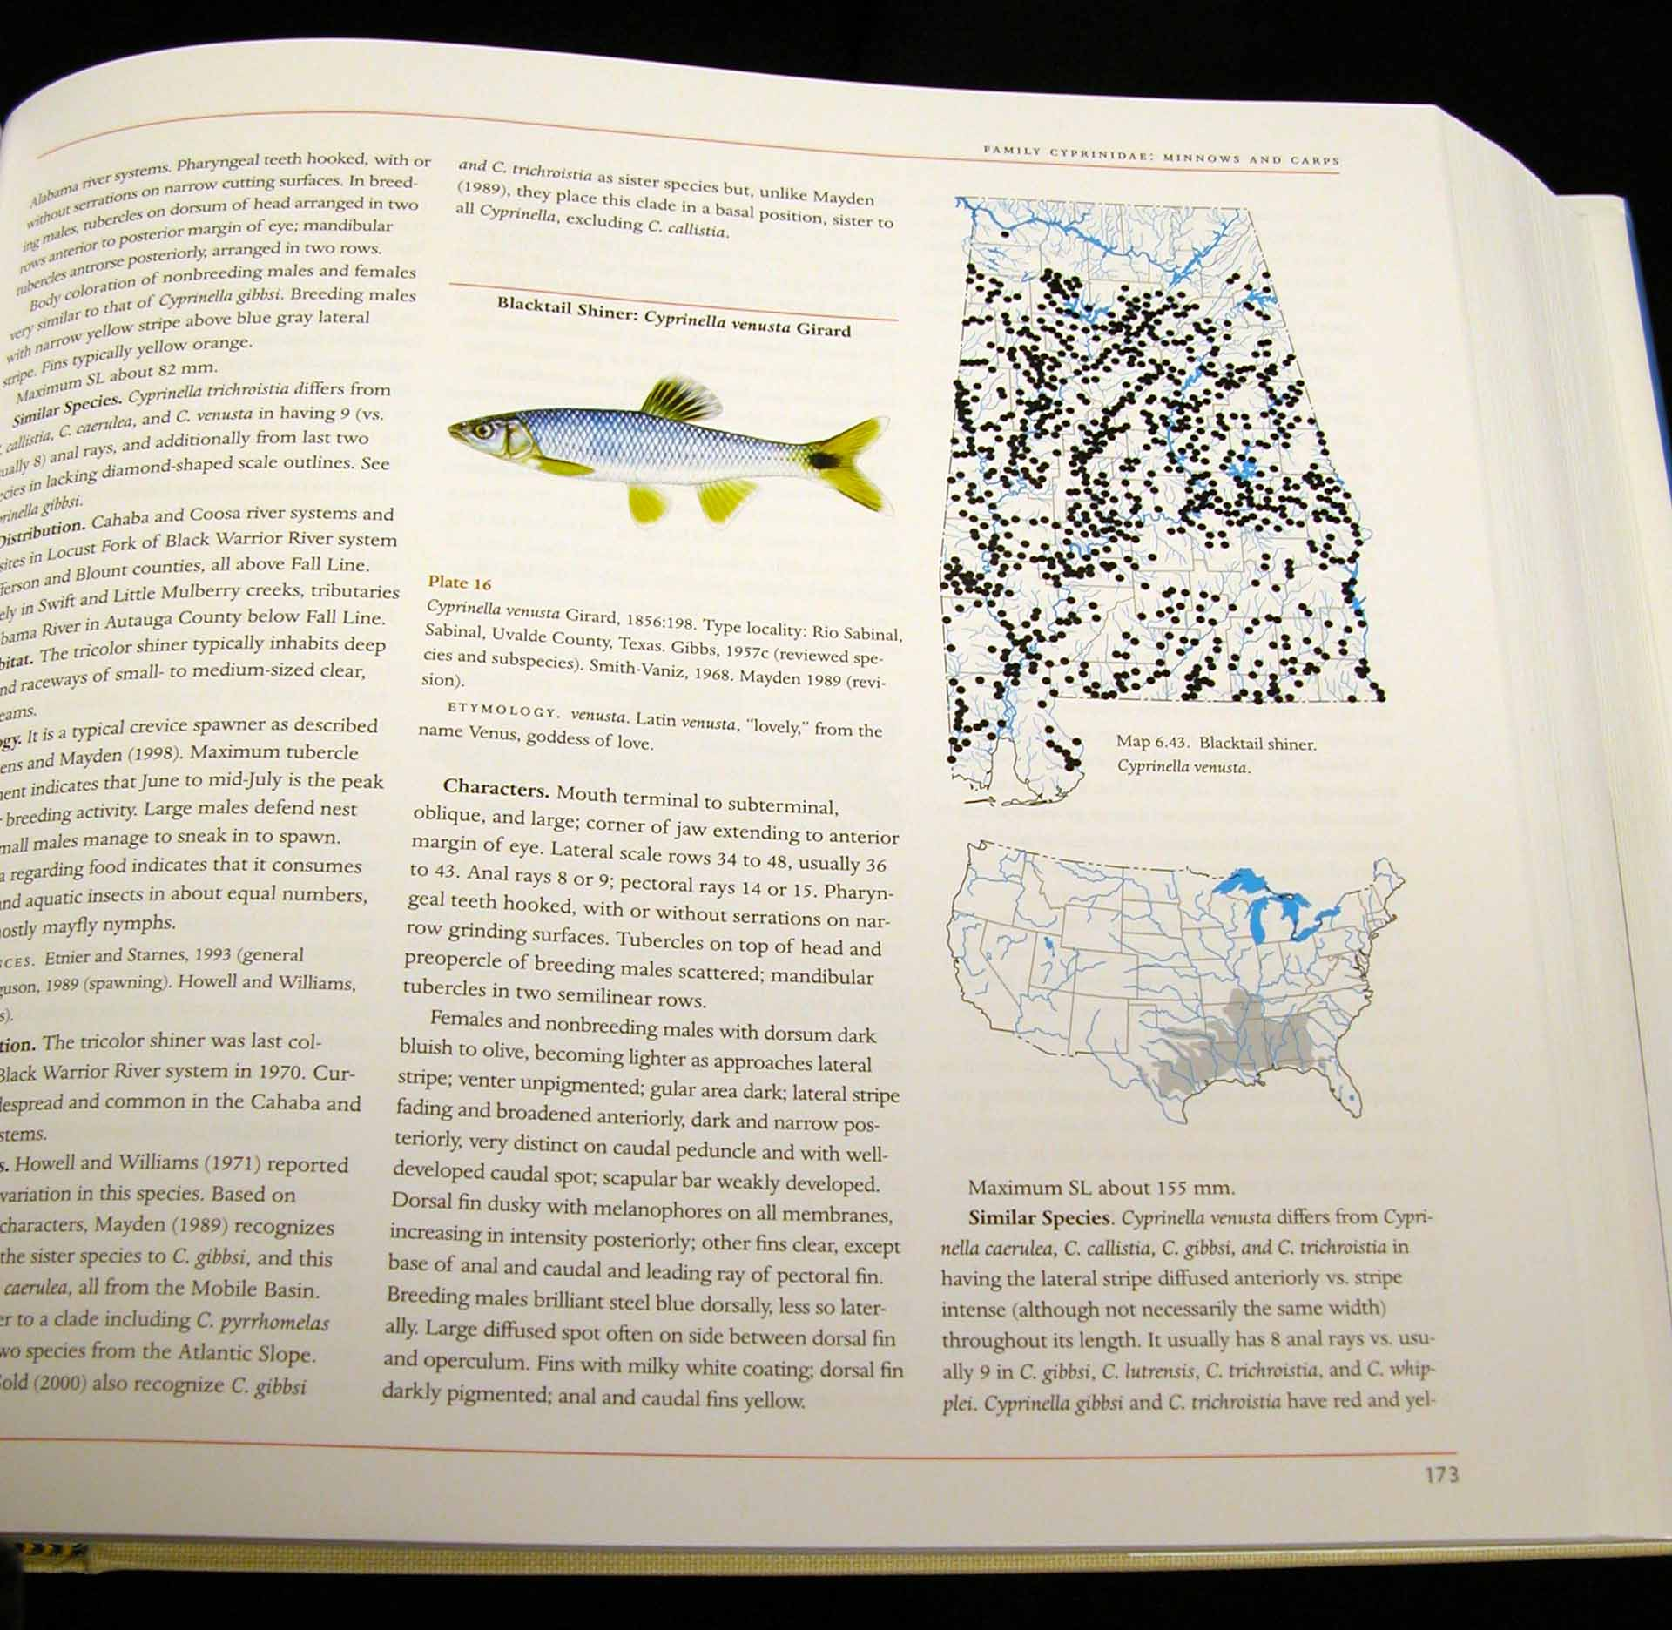
Species account in Boschung et al.’s Fishes of Alabama
Color illustrations of species.
State and overall
U.S. distribution
depicted on
computer- generated
colored maps.
General description
and characteristics.
Similar species.
Habitat and Biology.
Conservation status.
Systematics and
taxonomy.

Slide 6
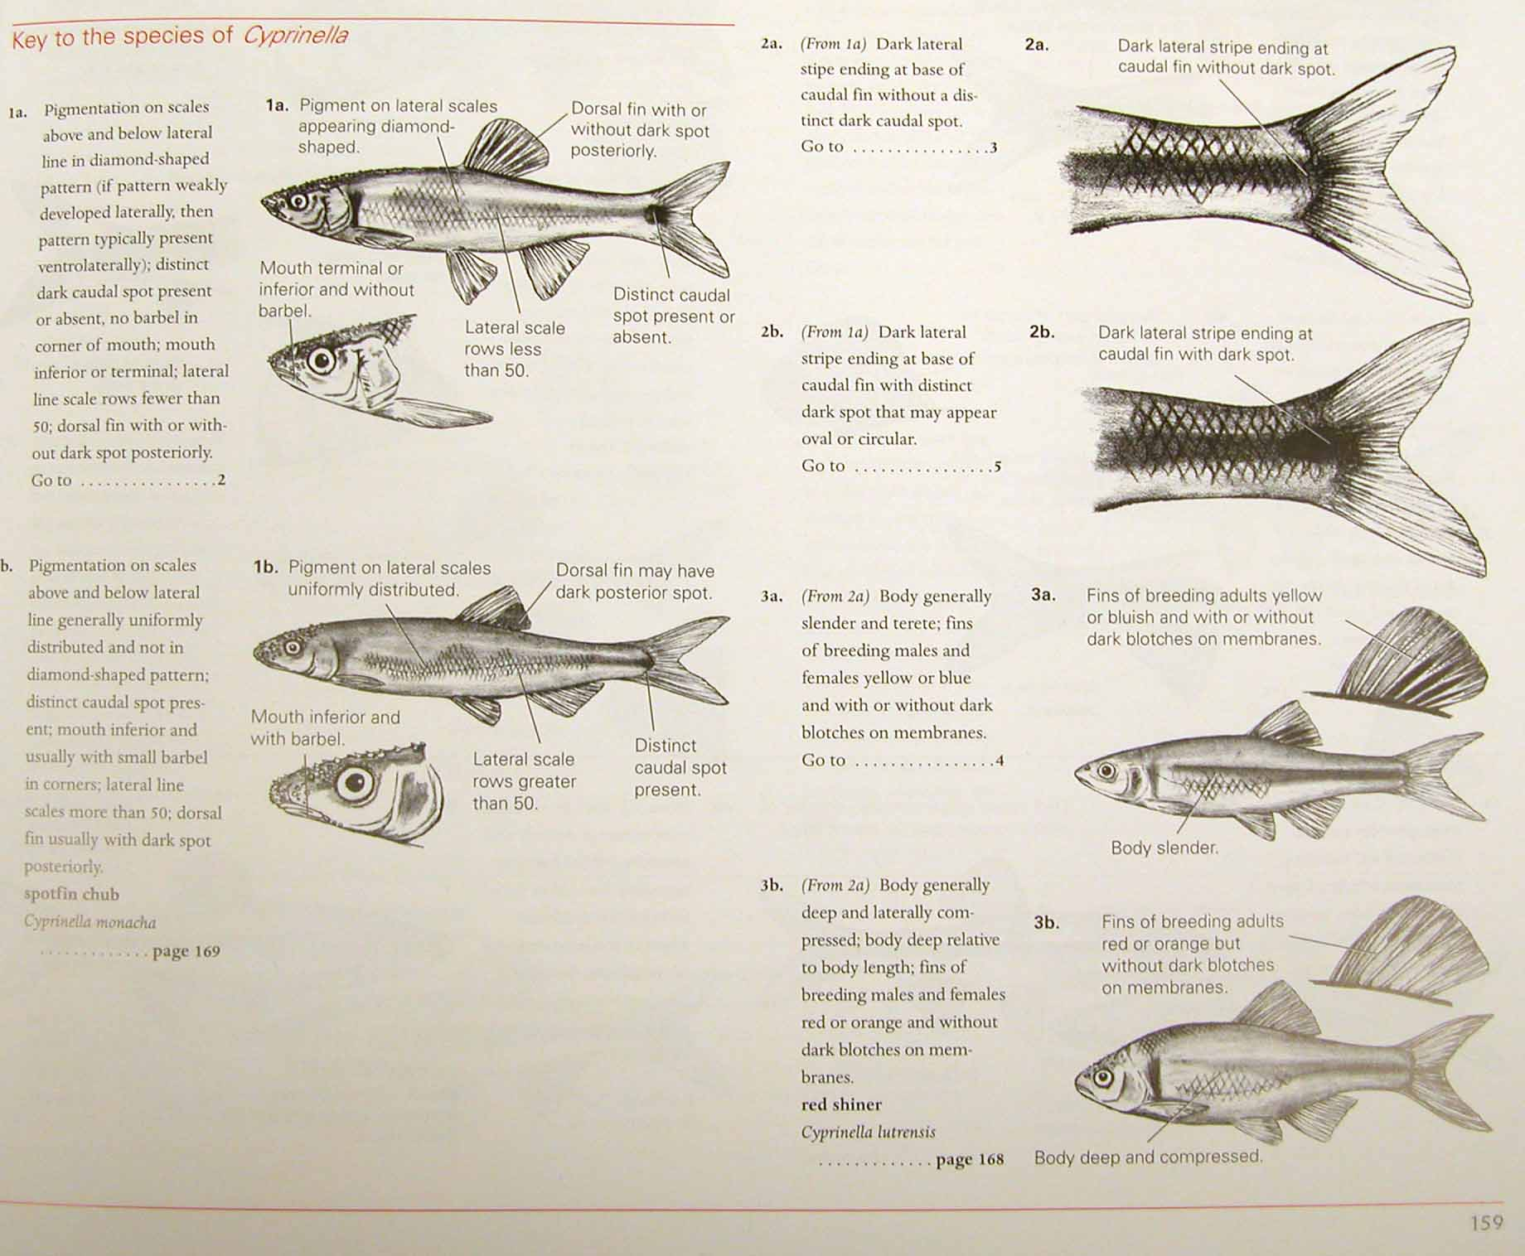
Keys in Boschung et al.’s Fishes of Alabama
Illustrated keys,
showing
distinguishing
characteristics of
each species to
ease species
identification.

Slide 7
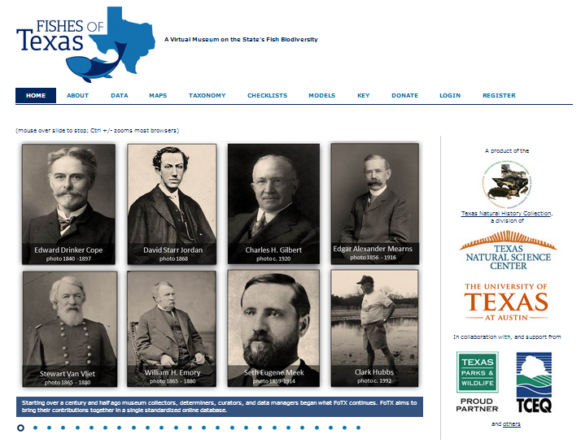
Fishes of Texas Project
Click on the graphic to view movie in a new window.

Slide 8
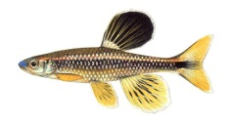
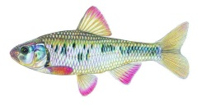
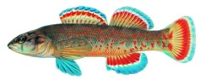
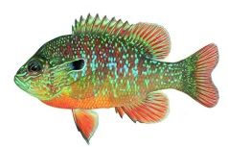
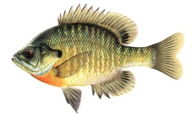
Inland and Coastal Fishes of Louisiana Book and Website
The new book will have all of the features of recent state fish guides, plus a number of special features such as:
Recipes, interesting anecdotes and facts about fish and fishing in Louisiana.
Will educate about the variety and importance of fish to Louisiana’s unique culture.
Will include a website:
http://fishesoflouisiana.org
Inland and Coastal Fishes of Louisiana
Henry L. Bart Jr.

Slide 9
A lot has changed since Douglas’ Fishes of Louisiana
Douglas (1974) treated 148 species of freshwater and diadromous fishes.
Douglas and Jordan (2002) reported 170 species (still limited to freshwater and diadromous fishes)
Our tally includes 219 species: 165 freshwater or diadromous species and 54 species of marine fishes that spend significant amounts of time in freshwater…

Slide 10
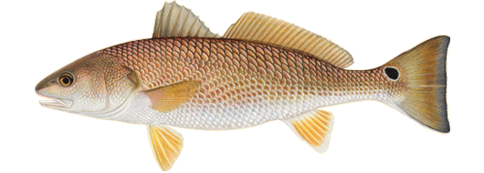
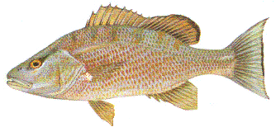
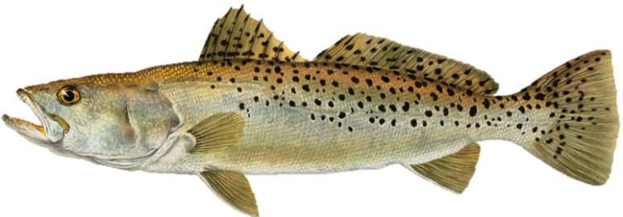
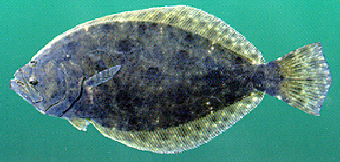
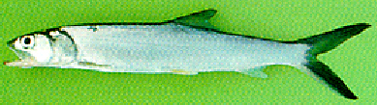
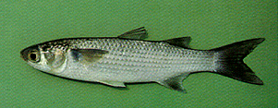
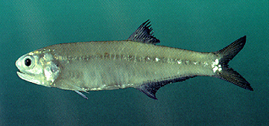
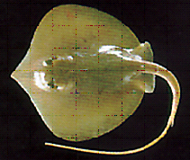
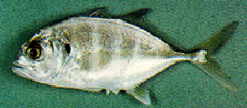
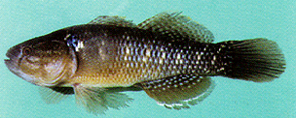
Marine invaders
Stingray, anchovy,
ladyfish, mullets,
sleepers, gobies, jacks,
drum, flounders,
mackerel, pipefishes,
needlefish, eels,
snapper, mojarra

Slide 11
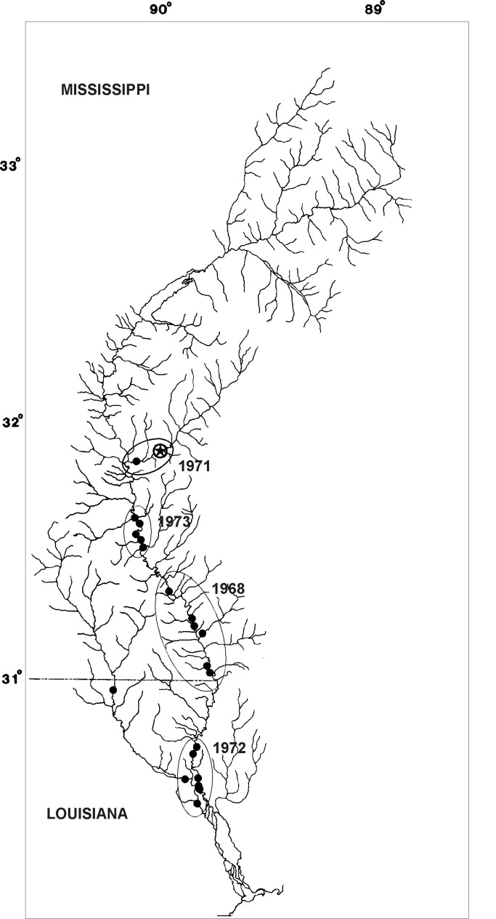
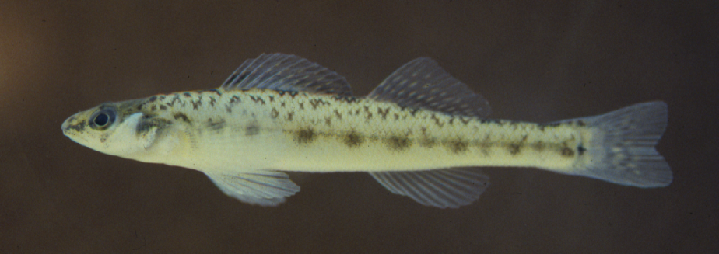
Some species have been lost…
Pearl darter, Percina aurora
Last collected in the
Pearl River in 1973

Slide 12
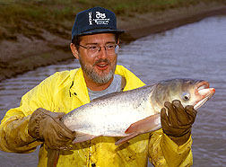
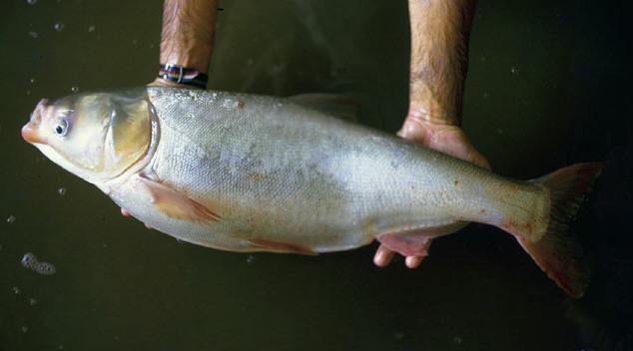
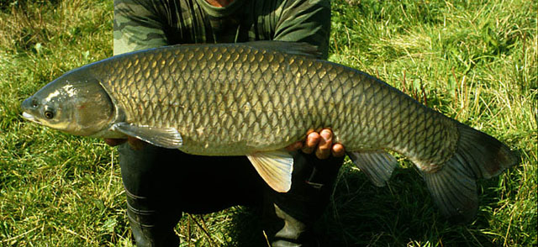
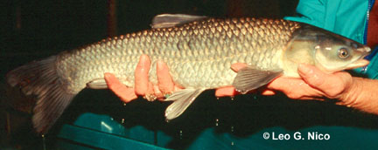
Some species have been added (Invasive Asian “major carp” species)
Silver carp Hypophthalmichthys molitrix
Bighead carp Hypophthalmichthys molitrix
Grass carp Ctenopharyngodon idella
Black carp Mylopharyngodon piceus

Slide 13
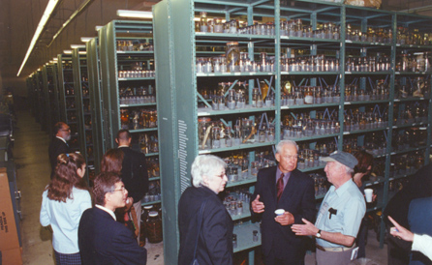
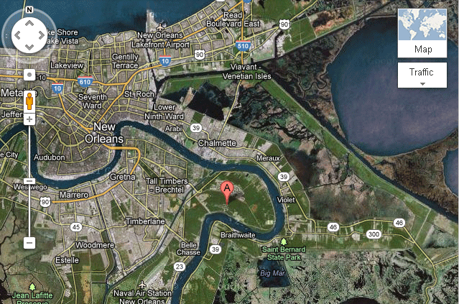
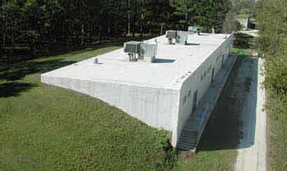
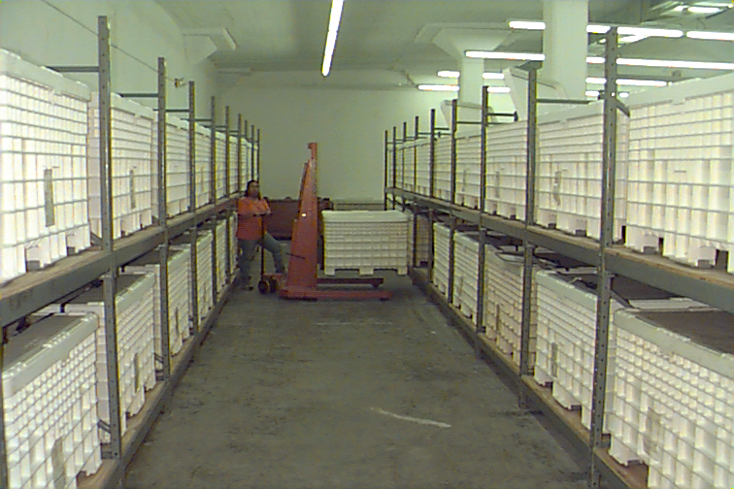
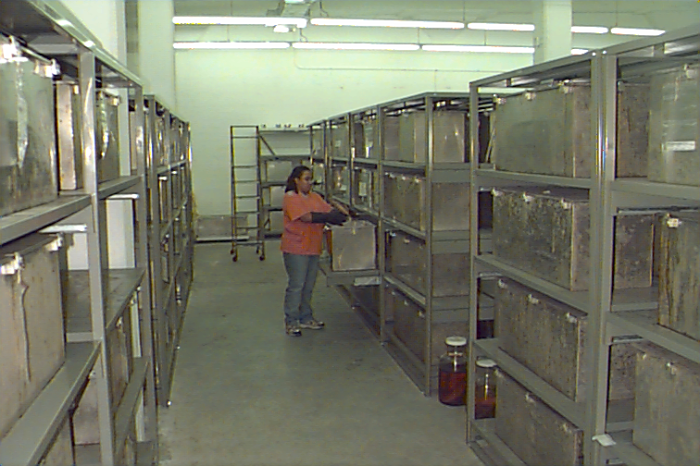
Royal D. Suttkus Fish Collection
Project would use the specimens and information resources of the RDS Fish Collection.
Largest collection of post-larval fishes in the world (over 7 million specimens);
National Center of Ichthyology Research Resource.

Slide 14
































Hosted at TUBRI
71 institutional data providers
>4 million specimen lots
20+ million specimens
61% georeferenced

Slide 15
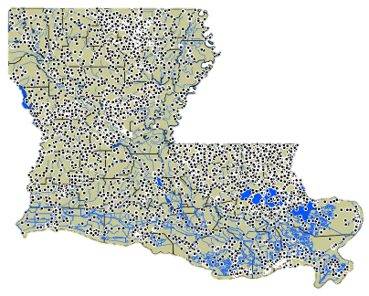
Louisiana Fish Records
TUBRI, ULM and FishNet2 records provide comprehensive coverage of the state of Louisiana from 1886 to present.
Supports online mapping of species occurrences.

Slide 16
Website
Printed books become obsolete within a few years of publication; website is dynamic and continues to expand/evolve as new information is added.
Website will be constructed first.
Will include species information pages and maps of actual and modeled species distributions.
Visitors will be able to search for species of interest by name or image, register as a contributor, and enter information (familiar names, anecdotes, recipes, experiences) to a project web portal.

Slide 17

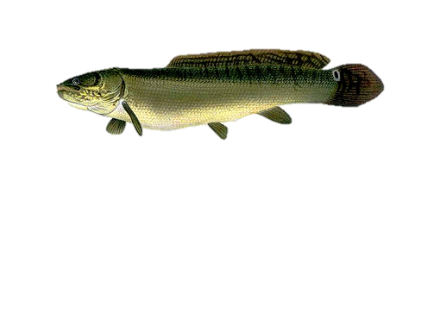

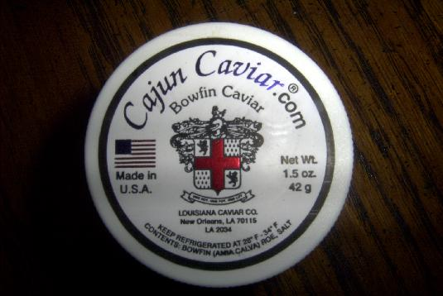
Louisiana Fish Recipes
Choupique (Bowfin),
Amia calva

Slide 18
Timetable
We anticipate that the book will take 5 years to complete.
Intermediate reports will be published annually - including an updated species checklist, distribution atlas, and various data-analysis summaries - to inform the scientific community and general public about our progress.
The basic structure of the website will be produced within the first two years and will continue to evolve beyond the project end date through the work of dedicated professional editors.
We will work with educators to develop special education resources on Louisiana fishes.

Slide 19
Estimated Cost
Estimated 5-year costs of ~$1.3M (320K per year for first two years and $220K per year next three years), mostly in salaries for professional staff, plus dedicated web server, travel to photograph specimens in life colors, and institutional indirect costs.
Also includes estimated costs of printing a book either at LSU Press or University of Louisiana Press.

Slide 20
Many thanks for your attention!
hbartjr@tulane.edu

